Slide 1
Self-Publishing Options
Making sense of the choices in today’s digital world

Slide 2




Disclaimer:
I hope this information may prove useful in
your journey to self-publishing.
The recommendations I make are based on my research and that of others, but you must do your own research to find the best publisher for your needs.
NOTE: As soon as this presentation is over, some or all
of the material will be out of date or obsolete.

Slide 3
Why Self-Publish?
You haven’t had success finding an agent, or you don’t want to bother with that.
You want to earn more money per book.
You want control over your work.
You want a book now.

Slide 4
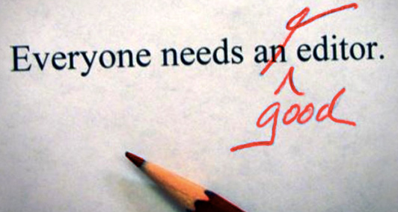
Before You Publish . . .
Make sure your manuscript is the best it can be.
  Look for mistakes in grammar, spelling, organization, consistency, and pace.
  Use self-editing tools.
  Join a critique group.
  Have your work edited by a professional.

Slide 5
Print book, ebook, or both?
Ebooks are easiest & least expensive to create, and they offer options for color and hyperlinks.
Print books require more work and expense, but allow for specialized layouts and typesetting.
You can create and sell both.

Slide 6
Gather Your Tools
Edited manuscript, including front matter, etc., in Microsoft Word or other program.
Manuscript layout, if specialized print book.
Front cover (ebook) or cover spread (print).
ISBN (or use one supplied by company).
Category/genre.
Metadata and keywords.

Slide 7
Three Ways to Self-Publish
Hire a full-service company to act as your publisher.
Work with a “hybrid” publisher.
Self-publish on your own, hiring any freelance assistance you need, and work directly with retailers and distributors to sell your book.

Slide 8
D.I.Y. Self-Publishing
You can make your print or ebook available for sale in the most important markets yourself—without third-party help.
Companies that assist you are largely unnecessary, especially if you’re only publishing an ebook.
You can access the same level of online retail distribution as a traditional published author by using “on demand” services.

Slide 9

How On Demand Services Work
Services are FREE.
You rarely pay an upfront fee. When you do, expect to earn 100% net on sales.
If you don’t pay an upfront fee, expect the service to keep a percentage of your sales.

Slide 10
How On Demand Services Work
At-will and nonexclusive.
With all on-demand retailers, you can upload your work at any time and make it available for sale. You can also take it down at any time.* You can upload new versions, change the price, cover, and description. You can sell your work through multiple services
and through your own website.
* Amazon’s KDP Select requires an exclusive 3-month commitment at a set price.

Slide 11
Using On Demand Services
Little technical expertise is required.
Major services offer automated tools for uploading and converting your files and listing your work for sale.
They also offer free guides and tutorials to help ensure your files are formatted correctly.

Slide 12
Retailers and Distributors
To compete in the self-pub marketplace, you must sell your book on Amazon. You can do this yourself using KDP, Amazon’s publishing service.
I recommend that you sell and distribute directly through KDP (for Amazon) and also use a distributor like Draft2Digital or IngramSpark to reach everyone else.

Slide 13
Print On Demand Recommendations
Using IngramSpark or Draft2Digital and KDP maximizes your profits and ensures the print edition of your book can be ordered and stocked everywhere.
Why?
Independent bookstores don’t like ordering books from KDP/Amazon, their key competitor.

Slide 14
Print On Demand Recommendations
However, if you use IngramSpark or Draft2Digital to fulfill orders through Amazon, you will reduce your profits.
Why?
Amazon offers more favorable terms when selling books generated through KDP. Therefore, it’s better financially to use KDP—but only for Amazon orders.

Slide 15
Manuscript Formatting in MS Word (or equivalent)
Following is Amazon’s set of instructions for manuscript formatting at KDP. Their guidelines present good information for all publishing services.
In a nutshell:
File Format: Save your content in DOC or DOCX format.
Layout: You can use Word’s default paragraph indentations, bold characters, italics and headings. Avoid special fonts, headers, and footers.
Indents: Don’t use spaces or tabs. Learn to use indents.
Page Breaks: Insert a page break at the end of every chapter.
Image Placement: Insert JPEG images with center alignment. Don’t copy and paste from another source.
Don’t include the cover image in your manuscript file.
Spellcheck and Grammar check: Use Word’s built-in spellcheck and grammar tools, but proofread your file manually as well.

Slide 16
Preparing Your Book Layout
KDP’s “Kindle Create”: Produces PDF layouts for print books and mobi files for Amazon ebooks.*
Draft2Digital and Reedsy: You can upload your Word doc for conversion to an “epub” file (even if you don’t use them as your distributor) and PDF production for print books.
Scrivener and Vellum: Software writing programs
(not free) that export epub and PDF files. Vellum is for Mac only.
* Recently, Amazon no longer requires mobi files and accepts epubs.

Slide 17
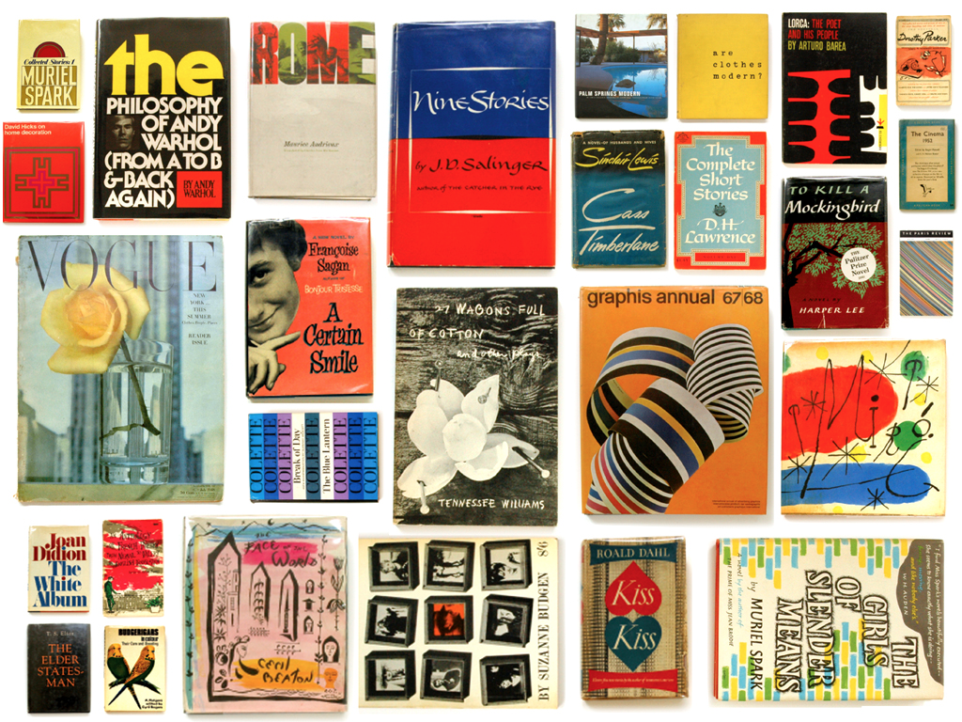
Designing Your Cover
Your cover is the first thing
readers will see.
If it doesn’t compel readers to look further, they will never see your words.
Notes:
You have little control over how the cover displays. Readers may see the cover in black and white, grayscale, high resolution, low resolution, thumbnail size, or full size, depending on their e-reading devices.

Slide 18
Designing an ebook Cover
“A ‘good’ cover isn’t the prettiest or even best-designed cover. It’s the one that sells the book.”
—Derek Murphy
For this reason (and more), it’s best to hire a professional to create your book cover.

Slide 19

Your Cover Is Packaging
It’s there to sell your book.
A powerful cover will …
Instantly let readers know the genre, mood, subject matter, setting, and emotional payout (without giving it away).
Look professional.
Look like other bestsellers in the genre without looking exactly like any specific one.

Slide 20


The Law of Attraction
Choose a great title before you begin cover design. If you pick a one-word title, your cover must work harder to compensate, and vice-versa.
Your cover shouldn’t explain anything. Its job is to attract a reader in one second.
Your cover should look like it belongs with the gang. It’s better to be a cliché and sell books than to stand out and sell none.

Slide 21

How Do You Do That?
Include just enough information to get the point across.
If you have mixed genres, decide which market you’ll appeal to (choose the largest).*
If you try to appeal to everyone,
chances are you’ll fail.
* Search Google for the most popular genres
(or those that make the most money).

Slide 22
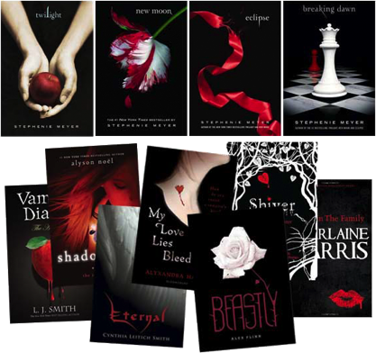
Fiction Cover
Focus on emotion.
Appeal to the heart.
The cover elements aren’t terribly important.
Convey fear by using red,
black, or white. For happiness, use light blue or yellow.
Use a model with an emotional face or a beautiful landscape.
“As a publisher you would be mad not to put a book out there with a black and red cover. We did do a black, red and white cover (Shiver)
and we did do very well.” – Laura Rennert

Slide 23

The Details
Readers don’t care about the details. A better picture, though less precisely matching, often sells more books than a picture that exactly matches the story.
Look at what the covers of the top 20 bestsellers have in common. Emulate those things. Follow design and genre conventions, so readers get a sense of your book at first glance.

Slide 24

Nonfiction Cover
This cover should be cerebral and yet instantly obvious. The reader shouldn’t have to guess.
The cover should also be new and unexpected, if possible. Combine two obvious symbols to embody the idea of the book.
Keep it simple. Put as little as possible on the cover.

Slide 25

Mistakes to Avoid
Don’t give your readers something to figure out. If readers are confused,
they’ll leave.
If you include awards, mention them
in text. Don’t include stickers.
Don’t use lots of different colors.
Many designers put a color wash layer over everything, so there are only one or two main colors (including text).
“Be clear before you are clever.”

Slide 26
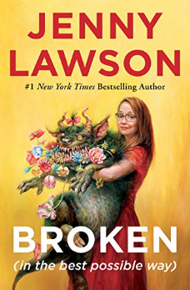
Emphasize What’s Important
“The average customer
spends eight seconds
looking at the cover and
fifteen on the back.”

Slide 27




So, If You Wrote a Werewolf Romance …
Your cover would need one or more
of the following:
“Werewolf” in the title.
A picture of a werewolf, preferably with another man or woman to show “romance.”
A subtitle or tagline that mentions werewolves, lycans, or hints at romance. You will sell more books than authors whose covers don’t convey the genre and who don’t use keywords.

Slide 28

Fonts
Make sure your fonts match the tone of your book. Your book that’s like GONE GIRL shouldn’t use This Font for the title.*
Don’t use more than two
(or maybe three) fonts.
Your tagline should be small.
Use white text on dark areas and vice-versa.
Also, more space between letters will give the text more power.
Your author name size depends on genre convention—not how famous you are.
* DIYbookcovers.com has a list of 300+ fonts by genre.

Slide 29

A Review of the Basics
Keep it simple. Busy covers rarely outsell simple ones.
Follow the guidelines of other books in your genre.
Fiction covers should elicit an emotional response. Nonfiction covers should quickly connect with the mind.
Include necessary items. Leave out the rest.
Emphasize what’s important.
Use appropriate typefaces.

Slide 30
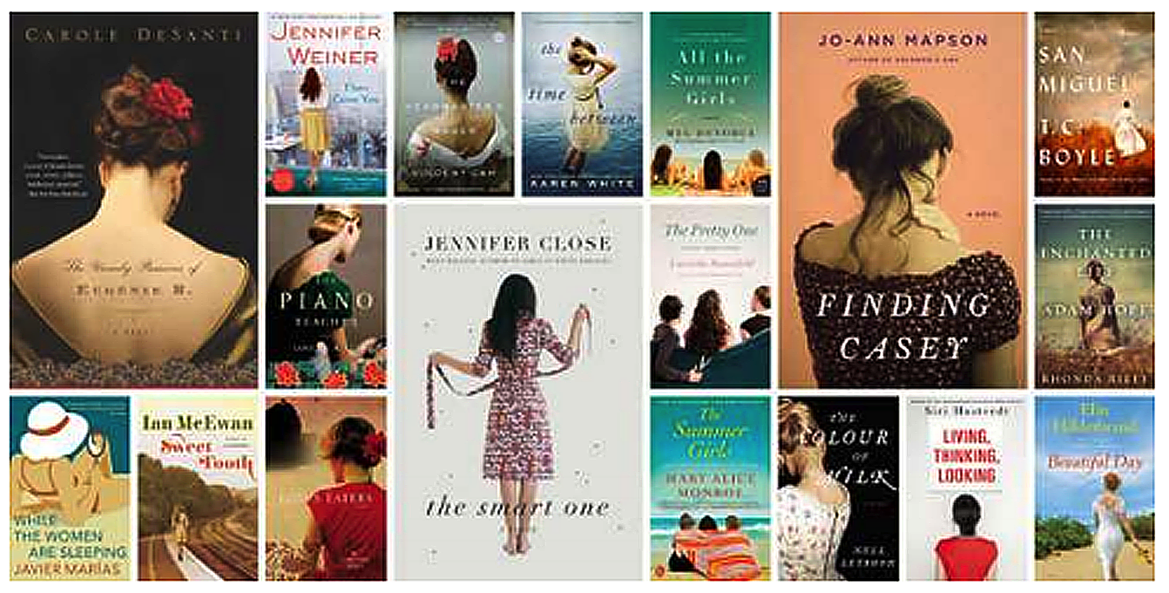
Research Your Genre

Slide 31
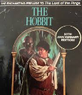

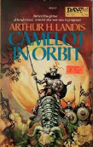


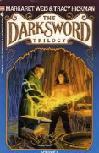
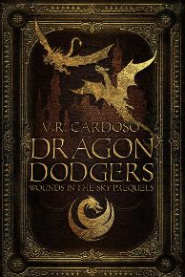

Slide 32




Branding a Series
Create a brand for your series through repetition of layout, font, style, and color, as well as the elements
of the story.

Slide 33
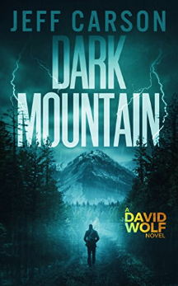

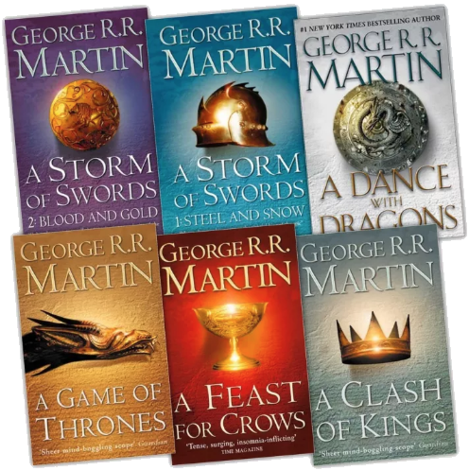



Slide 34
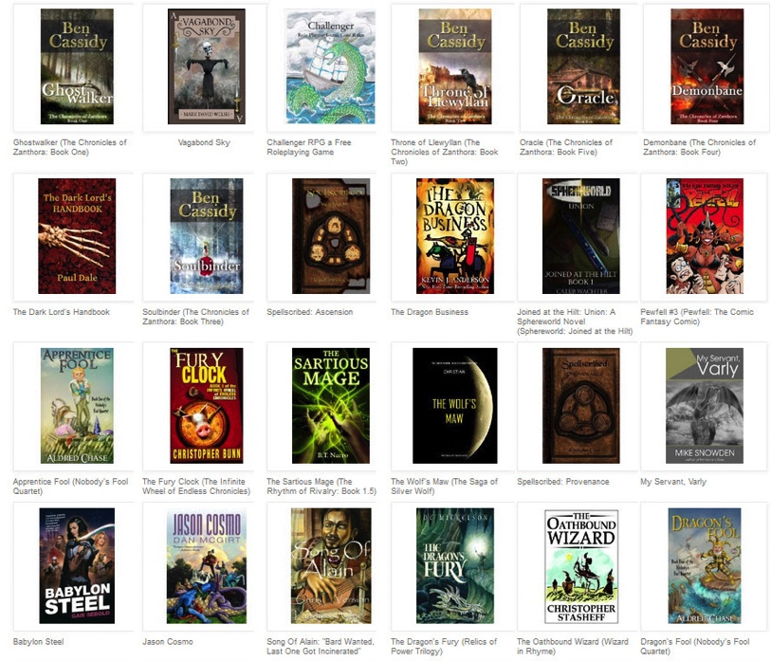
Design for Amazon.com
Your cover must stand out and be impactful and alluring as a thumbnail.
People read the text beside the thumbnail, so don’t worry if the thumb text isn’t legible. Some genres don’t call for big text, and using it could ruin the emotional impact of your cover.

Slide 35
Pricing Your ebook
Sales of ebooks depend on the quality of your work and
how well you market, but other factors are also at play:
Indie authors of fiction typically charge $0.99 to $2.99.
This pricing encourages readers to take a chance on you. Typically, the more well known you are, the more you can charge.
Nonfiction authors should price according to the competition and what the market will bear.
Amazon pays 70% royalty when Kindle ebooks are priced between $2.99 and $9.99. Over that range, the percentage
drops to 35%.

Slide 36
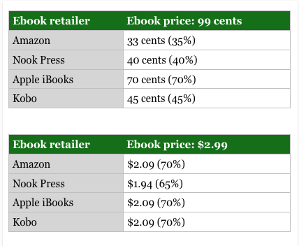
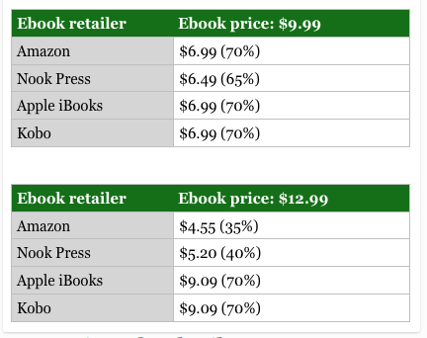
What Do eBook Retailers Pay?

Slide 37

Now the print side of
self-publishing.

Slide 38
How to Produce a Print Edition
There are two primary ways to make printed books
available for sale:
Print on demand (POD)
Traditional offset printing
Print-on-demand technology allows books to be printed
one at a time. This is the most popular way to produce
print copies of your book.
Even traditional publishers use POD to keep older titles in stock without committing to warehousing inventory.

Slide 39
Pros and Cons: Print on Demand
Pros
Few or no upfront costs.
Your POD book can be purchased at all the usual online and brick-and-mortar retail outlets (Amazon, Barnes & Noble, etc.), as well as distributed through Ingram, the largest U.S. book wholesaler.
It’s nearly impossible to tell the difference between a POD book and an offset-printed book.
Cons
The unit cost is greater than with offset, which generally leads to a higher retail price.

Slide 40
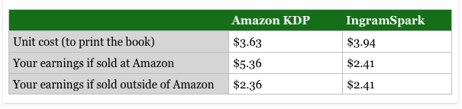
What Do Print-On-Demand Retailers Pay?
This is for a $14.99 standard 6×9 paperback, about 240 pages.

Slide 41
Pros and Cons: Offset Printing
Pros of offset printing
Lower unit cost than POD.
Higher quality production, especially for full-color books.
Cons of offset printing
Considerable upfront investment: $2,000 is the likely minimum, including printing and shipping costs.
Increased risk—what if the books don’t sell or you want to make a new edition before the old one sells out?
You’ll have books to warehouse and fulfill, unless you hire a third party to handle it for you, which incurs additional costs.

Slide 42
Getting Your Book into Stores
While it can be fairly straightforward and inexpensive to get a print book in your hands via print-on-demand services, it is nearly impossible to have a POD book stocked in bookstores.
Services may claim to distribute your book to stores and libraries. This is very different from selling your book to those outlets.
Bookstores almost never accept or stock titles from any self-publishing service or POD company, although they will order them for customers when asked, assuming the book appears in their system.

Slide 43
“Should I set up
a publishing company?”
The answer depends on your goals and long-term plans.
You may use your social security number for tax purposes and leave it at that. However, most serious self-publishers will set up an LLC at a minimum.

Slide 44
Regarding Copyright
(quoted from Copyright.gov)
When is my work protected?
Your work is under copyright the moment it is created and fixed in a tangible form that it is perceptible either directly or with the aid of a machine or device.
Do I have to register with your office to be protected?
No. In general, registration is voluntary. Copyright exists from the moment the work is created. You will have to register, however, if you wish to bring a lawsuit for infringement of a U.S. work.
Registration is recommended for a number of reasons. Many choose to register their works because they wish to have the facts of their copyright on the public record and have a certificate of registration. Registered works may be eligible for statutory damages and attorney's fees in successful litigation. Finally, if registration occurs within five years of publication, it is considered prima facie evidence in a court of law.

Slide 45
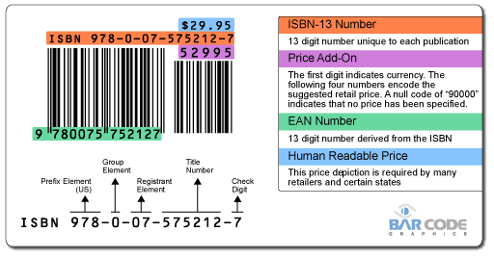
What are ISBN, EAN, & LCCN?
ISBN: International Standard Book Number. ISBNs are purchased by the publisher and cannot be sold or re-assigned.
An ISBN is required to
sell a book through traditional channels. Most self-publishing services will provide you with an ISBN, or you can obtain your own. (In the US, you can buy through MyIdentifiers.com.)
EAN Bookland Barcode: A machine-readable translation of the ISBN.
LCCN: Library of Congress Control Number assigned by the Library of Congress to titles it is likely to acquire.
Note: An ISBN is not required for basic distribution through most retailers. Many provide one free. You may also purchase one (or more) through MyIdentifiers.com. (Note: this is pricey).

